Slide 1
Natural Video Understanding
Andrew Floren

Slide 2
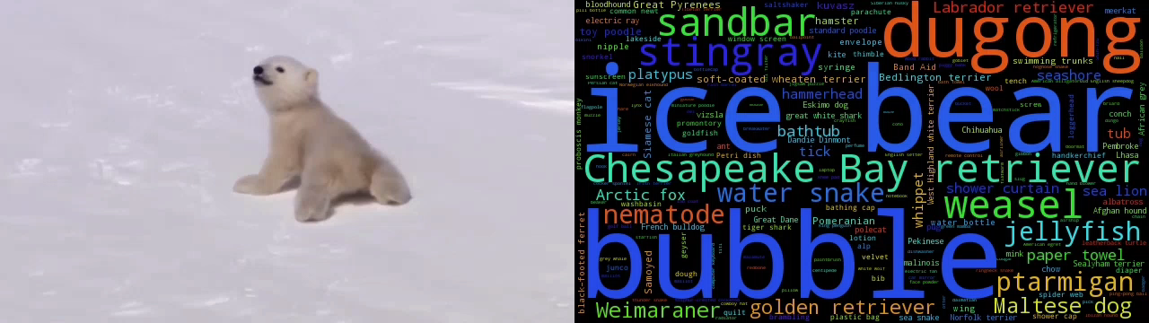
Summarize Video Content

Slide 3
Classification

Slide 4
Deep Convolutional Network

Slide 5
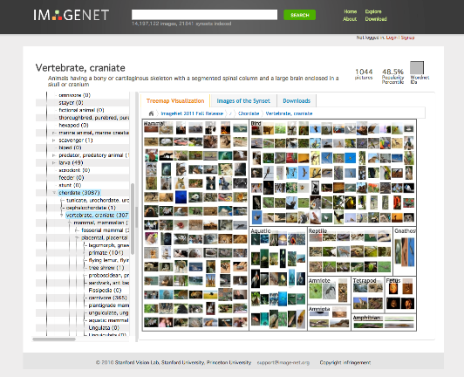
Dataset

Slide 6
Labels
1000 distinct classes chosen from the image-net.org database for training
African elephant, African grey, African hunting dog, agama, agaric, aircraft carrier, Airedale, airliner, airship, albatross, alligator lizard, alp, altar, ambulance, American alligator, American black bear, American chameleon, American coot, American egret, American lobster, American Staffordshire terrier, amphibian, analog clock, anemone fish, Angora, ant, apiary, Appenzeller, apron, Arabian camel, Arctic fox, armadillo, artichoke, ashcan, assault rifle, Australian terrier, axolotl, baboon, backpack, badger, bagel, bakery, balance beam, bald eagle, balloon, ballplayer, ballpoint, banana, Band Aid, banded gecko, banjo, bannister, barbell, barber chair, barbershop, barn, barn spider, barometer, barracouta, barrel, barrow, baseball, basenji, basketball, basset, bassinet, bassoon, bath towel, bathing cap, bathtub, beach wagon, beacon, beagle, beaker, bearskin, beaver, Bedlington terrier, bee, bee eater, beer bottle, beer glass, bell cote, bell pepper, Bernese mountain dog, bib, bicycle-built-for-two, bighorn, bikini, binder, binoculars, birdhouse, bison, bittern, black and gold garden spider, black grouse, black stork, black swan, black widow, black-and-tan coonhound, black-footed ferret, Blenheim spaniel, bloodhound, bluetick, boa constrictor, boathouse, bobsled, bolete, bolo tie, bonnet, book jacket, bookcase, bookshop, Border collie, Border terrier, borzoi, Boston bull, bottlecap, Bouvier des Flandres, bow, bow tie, box turtle, boxer, Brabancon griffon, brain coral, brambling, brass, brassiere, breakwater, breastplate, briard, Brittany spaniel, broccoli, broom, brown bear, bubble, bucket, buckeye, buckle, bulbul, bull mastiff, bullet train, bulletproof vest, bullfrog, burrito, bustard, butcher shop, butternut squash, cab, cabbage butterfly, cairn, caldron, can opener, candle, cannon, canoe, capuchin, car mirror, car wheel, carbonara, Cardigan, cardigan, cardoon, carousel, carpenter’s kit, carton, cash machine, cassette, cassette player, castle, catamaran, cauliflower, CD player, cello, cellular telephone, centipede, chain, chain mail, chain saw, chainlink fence, chambered nautilus, cheeseburger, cheetah, Chesapeake Bay retriever, chest, chickadee, chiffonier, Chihuahua, chime, chimpanzee, china cabinet, chiton, chocolate sauce, chow, Christmas stocking, church, cicada, cinema, cleaver, cliff, cliff dwelling, cloak, clog, clumber, cock, cocker spaniel, cockroach, cocktail shaker, coffee mug, coffeepot, coho, coil, collie, colobus, combination lock, comic book, common iguana, common newt, computer keyboard, conch, confectionery, consomme, container ship, convertible, coral fungus, coral reef, corkscrew, corn, cornet, coucal, cougar, cowboy boot, cowboy hat, coyote, cradle, crane, crane, crash helmet, crate, crayfish, crib, cricket, Crock Pot, croquet ball, crossword puzzle, crutch, cucumber, cuirass, cup, curly-coated retriever, custard apple, daisy, dalmatian, dam, damselfly, Dandie Dinmont, desk, desktop computer, dhole, dial telephone, diamondback, diaper, digital clock, digital watch, dingo, dining table, dishrag, dishwasher, disk brake, Doberman, dock, dogsled, dome, doormat, dough, dowitcher, dragonfly, drake, drilling platform, drum, drumstick, dugong, dumbbell, dung beetle, Dungeness crab, Dutch oven, ear, earthstar, echidna, eel, eft, eggnog, Egyptian cat, electric fan, electric guitar, electric locomotive, electric ray, English foxhound, English setter, English springer, entertainment center, EntleBucher, envelope, Eskimo dog, espresso, espresso maker, European fire salamander, European gallinule, face powder, feather boa, fiddler crab, fig, file, fire engine, fire screen, fireboat, flagpole, flamingo, flatcoated retriever, flatworm, flute, fly, folding chair, football helmet, forklift, fountain, fountain pen, four-poster, fox squirrel, freight car, French bulldog, French horn, French loaf, frilled lizard, frying pan, fur coat, gar, garbage truck, garden spider, garter snake, gas pump, gasmask, gazelle, German shepherd, German short-haired pointer, geyser, giant panda, giant schnauzer, gibbon, Gila monster, go-kart, goblet, golden retriever, goldfinch, goldfish, golf ball, golfcart, gondola, gong, goose, Gordon setter, gorilla, gown, grand piano, Granny Smith, grasshopper, Great Dane, great grey owl, Great Pyrenees, great white shark, Greater Swiss Mountain dog, green lizard, green mamba, green snake, greenhouse, grey fox, grey whale, grille, grocery store, groenendael, groom, ground beetle, guacamole, guenon, guillotine, guinea pig, gyromitra, hair slide, hair spray, half track, hammer, hammerhead, hamper, hamster, hand blower, handheld computer, handkerchief, hard disc, hare, harmonica, harp, hartebeest, harvester, harvestman, hatchet, hay, head cabbage, hen, hen-of-the-woods, hermit crab, hip, hippopotamus, hog, hognose snake, holster, home theater, honeycomb, hook, hoopskirt, horizontal bar, hornbill, horned viper, horse cart, hot pot, hotdog, hourglass, house finch, howler monkey, hummingbird, hyena, ibex, Ibizan hound, ice bear, ice cream, ice lolly, impala, Indian cobra, Indian elephant, indigo bunting, indri, iPod, Irish setter, Irish terrier, Irish water spaniel, Irish wolfhound, iron, isopod, Italian greyhound, jacamar, jack-o’-lantern, jackfruit, jaguar, Japanese spaniel, jay, jean, jeep, jellyfish, jersey, jigsaw puzzle, jinrikisha, joystick, junco, keeshond, kelpie, Kerry blue terrier, killer whale, kimono, king crab, king penguin, king snake, kit fox, kite, knee pad, knot, koala, Komodo dragon, komondor, kuvasz, lab coat, Labrador retriever, lacewing, ladle, ladybug, Lakeland terrier, lakeside, lampshade, langur, laptop, lawn mower, leaf beetle, leafhopper, leatherback turtle, lemon, lens cap, Leonberg, leopard, lesser panda, letter opener, Lhasa, library, lifeboat, lighter, limousine, limpkin, liner, lion, lionfish, lipstick, little blue heron, llama, Loafer, loggerhead, long-horned beetle, lorikeet, lotion, loudspeaker, loupe, lumbermill, lycaenid, lynx, macaque, macaw, Madagascar cat, magnetic compass, magpie, mailbag, mailbox, maillot, maillot, malamute, malinois, Maltese dog, manhole cover, mantis, maraca, marimba, marmoset, marmot, mashed potato, mask, matchstick, maypole, maze, measuring cup, meat loaf, medicine chest, meerkat, megalith, menu, Mexican hairless, microphone, microwave, military uniform, milk can, miniature pinscher, miniature poodle, miniature schnauzer, minibus, miniskirt, minivan, mink, missile, mitten, mixing bowl, mobile home, Model T, modem, monarch, monastery, mongoose, monitor, moped, mortar, mortarboard, mosque, mosquito net, motor scooter, mountain bike, mountain tent, mouse, mousetrap, moving van, mud turtle, mushroom, muzzle, nail, neck brace, necklace, nematode, Newfoundland, night snake, nipple, Norfolk terrier, Norwegian elkhound, Norwich terrier, notebook, obelisk, oboe, ocarina, odometer, oil filter, Old English sheepdog, orange, orangutan, organ, oscilloscope, ostrich, otter, otterhound, overskirt, ox, oxcart, oxygen mask, oystercatcher, packet, paddle, paddlewheel, padlock, paintbrush, pajama, palace, panpipe, paper towel, papillon, parachute, parallel bars, park bench, parking meter, partridge, passenger car, patas, patio, pay-phone, peacock, pedestal, Pekinese, pelican, Pembroke, pencil box, pencil sharpener, perfume, Persian cat, Petri dish, photocopier, pick, pickelhaube, picket fence, pickup, pier, piggy bank, pill bottle, pillow, pineapple, ping-pong ball, pinwheel, pirate, pitcher, pizza, plane, planetarium, plastic bag, plate, plate rack, platypus, plow, plunger, Polaroid camera, pole, polecat, police van, pomegranate, Pomeranian, poncho, pool table, pop bottle, porcupine, pot, potpie, potter’s wheel, power drill, prairie chicken, prayer rug, pretzel, printer, prison, proboscis monkey, projectile, projector, promontory, ptarmigan, puck, puffer, pug, punching bag, purse, quail, quill, quilt, racer, racket, radiator, radio, radio telescope, rain barrel, ram, rapeseed, recreational vehicle, red fox, red wine, red wolf, redbacked sandpiper, red-breasted merganser, redbone, redshank, reel, reflex camera, refrigerator, remote control, restaurant, revolver, rhinoceros beetle, Rhodesian ridgeback, rifle, ringlet, ringneck snake, robin, rock beauty, rock crab, rock python, rocking chair, rotisserie, Rottweiler, rubber eraser, ruddy turnstone, ruffed grouse, rugby ball, rule, running shoe, safe, safety pin, Saint Bernard, saltshaker, Saluki, Samoyed, sandal, sandbar, sarong, sax, scabbard, scale, schipperke, school bus, schooner, scoreboard, scorpion, Scotch terrier, Scottish deerhound, screen, screw, screwdriver, scuba diver, sea anemone, sea cucumber, sea lion, sea slug, sea snake, sea urchin, Sealyham terrier, seashore, seat belt, sewing machine, Shetland sheepdog, shield, Shih-Tzu, shoe shop, shoji, shopping basket, shopping cart, shovel, shower cap, shower curtain, siamang, Siamese cat, Siberian husky, sidewinder, silky terrier, ski, ski mask, skunk, sleeping bag, slide rule, sliding door, slot, sloth bear, slug, snail, snorkel, snow leopard, snowmobile, snowplow, soap dispenser, soccer ball, sock, soft-coated wheaten terrier, solar dish, sombrero, sorrel, soup bowl, space bar, space heater, space shuttle, spaghetti squash, spatula, speedboat, spider monkey, spider web, spindle, spiny lobster, spoonbill, sports car, spotlight, spotted salamander, squirrel monkey, Staffordshire bullterrier, stage, standard poodle, standard schnauzer, starfish, steam locomotive, steel arch bridge, steel drum, stethoscope, stingray, stinkhorn, stole, stone wall, stopwatch, stove, strainer, strawberry, street sign, streetcar, stretcher, studio couch, stupa, sturgeon, submarine, suit, sulphur butterfly, sulphur-crested cockatoo, sundial, sunglass, sunglasses, sunscreen, suspension bridge, Sussex spaniel, swab, sweatshirt, swimming trunks, swing, switch, syringe, tabby, table lamp, tailed frog, tank, tape player, tarantula, teapot, teddy, television, tench, tennis ball, terrapin, thatch, theater curtain, thimble, three-toed sloth, thresher, throne, thunder snake, Tibetan mastiff, Tibetan terrier, tick, tiger, tiger beetle, tiger cat, tiger shark, tile roof, timber wolf, titi, toaster, tobacco shop, toilet seat, toilet tissue, torch, totem pole, toucan, tow truck, toy poodle, toy terrier, toyshop, tractor, traffic light, trailer truck, tray, tree frog, trench coat, triceratops, tricycle, trifle, trilobite, trimaran, tripod, triumphal arch, trolleybus, trombone, tub, turnstile, tusker, typewriter keyboard, umbrella, unicycle, upright, vacuum, valley, vase, vault, velvet, vending machine, vestment, viaduct, vine snake, violin, vizsla, volcano, volleyball, vulture, waffle iron, Walker hound, walking stick, wall clock, wallaby, wallet, wardrobe, warplane, warthog, washbasin, washer, water bottle, water buffalo, water jug, water ouzel, water snake, water tower, weasel, web site, weevil, Weimaraner, Welsh springer spaniel, West Highland white terrier, whippet, whiptail, whiskey jug, whistle, white stork, white wolf, wig, wild boar, window screen, window shade, Windsor tie, wine bottle, wing, wire-haired fox terrier, wok, wolf spider, wombat, wood rabbit, wooden spoon, wool, worm fence, wreck, yawl, yellow lady’s slipper, Yorkshire terrier, yurt, zebra, zucchini

Slide 7
Caffe
Implemented in Caffe (http://caffe.berkeleyvision.org/)
A deep learning framework
Define network structure and input format in human readable configuration files
Caffe can perform back-propagation training and classification on new inputs from configuration files

Slide 8

Example Classification

Slide 9
Classifying Video
Straightforward approach is to classify frame-by-frame
~4s per frame without GPU acceleration
Can classify frames in parallel
Video content tends to change slowly over-time
Classify at lower frame-rate
Rapid content shifts during scene changes
Try to identify scene changes using some heuristic

Slide 10
Implementation
For H.264 encoded video, classifying I-frames is a very practical approach
Easier to access I-frames in parallel
I-frames tend to occur approximately every 0.5s and at large scene changes
Parallel I-frame classification performed using Caffe and Apache Spark in a cluster hosted on the Google Cloud Platform

Slide 11
Scene Clustering
Clustering classification vectors yields natural scene boundaries
Averaging classification vectors within a cluster improves accuracy
Reduced memory and storage requirements when working with clusters

Slide 12
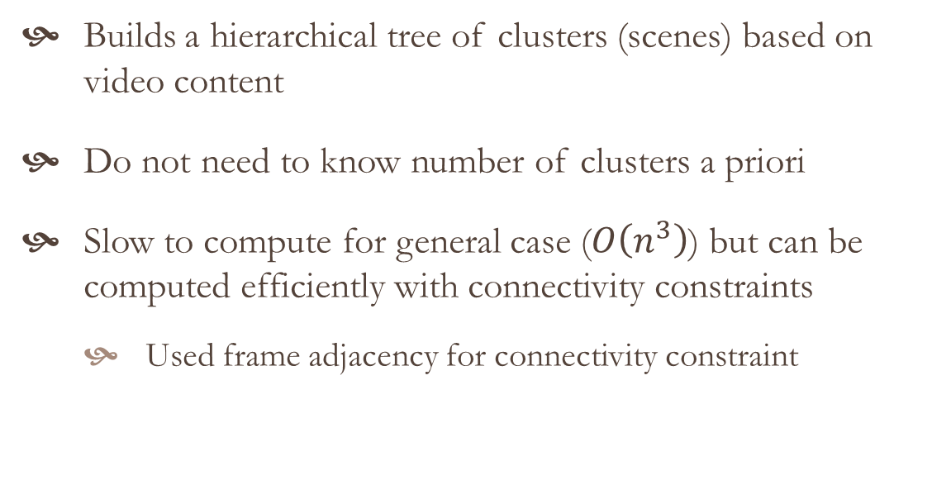
Agglomerative Clustering
Builds a hierarchical tree of clusters (scenes) based on video content
Do not need to know number of clusters a priori
Slow to compute for general case ($O\left(n^{3}\right)$) but can be computed efficiently with connectivity constraints
Used frame adjacency for connectivity constraint

Slide 13
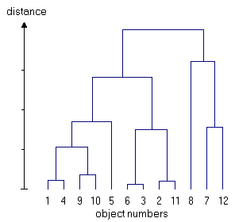
Dendrogram

Slide 14
Scene Search Example
http://compute.andrewfloren.com/

Slide 15
Potential Applications
Searching large databases of videos based on content, e.g., YouTube or Vine
Calculating content-based similarity of videos for recommendations
Improving quality assessment algorithms by accounting for image/video content contribution to opinion scores

Slide 16
Questions?

